Slide 1
Advanced SQL – IMDB Dataset Analysis
A Reinforcement Project
By: Raghul Prasanth.M
Course:DA & DS

Slide 2
Introduction
• This project analyzes a simplified version of the IMDB dataset.
• It includes details about movies, genres, actors, directors, and ratings.
• The goal is to reinforce SQL skills and extract meaningful insights.
• Provide actionable business insights

Slide 3
Dataset Structure
The dataset consists of six tables:
1. Movie – Basic movie details (title, year, duration, country, etc.)
2. Genre – Genres associated with each movie
3. Director Mapping – Links movies to directors
4. Role Mapping – Maps actors/actresses to movies
5. Names – Details about people (birthdates, height, known movies)
6. Ratings – Movie ratings, total votes, and median ratings

Slide 4
Project Objectives
• Reinforce key SQL concepts (joins, aggregation, filtering, grouping, order by,
limit)
• Analysis IMDB data to extract meaningful insights
• Document findings and improve data presentation skills
• Exploring trends in movies
•Ratings and Patterns in movies
• Analyzing a real-world movie dataset
• Handling missing values in key tables
• Optimizing SQL queries for large datasets.

Slide 5
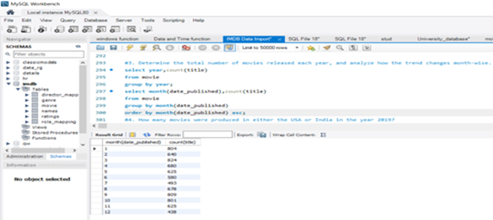
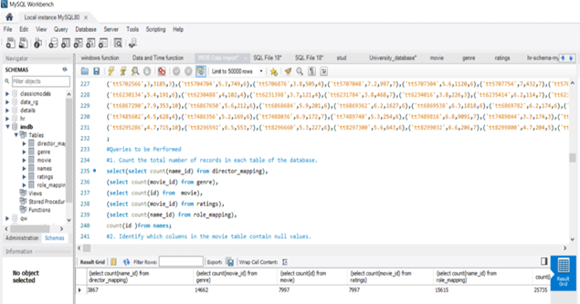
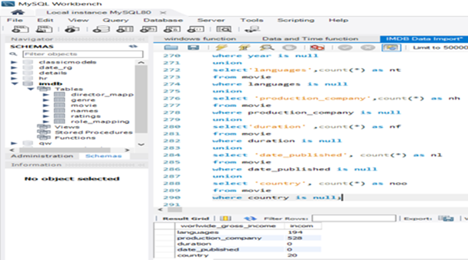
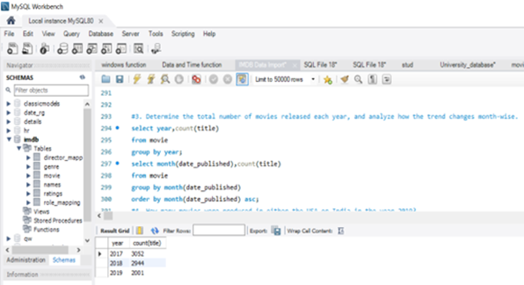
Key SQL Queries
• Counting total records in each table
• Identifying columns with NULL values
• Analyzing yearly and monthly movie release trends
• Finding the most common genres and top-rated movies
• Comparing average votes received by German vs. Italian movies are 12928.4357 and 11960.4673

Slide 6
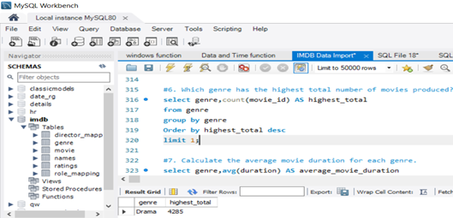
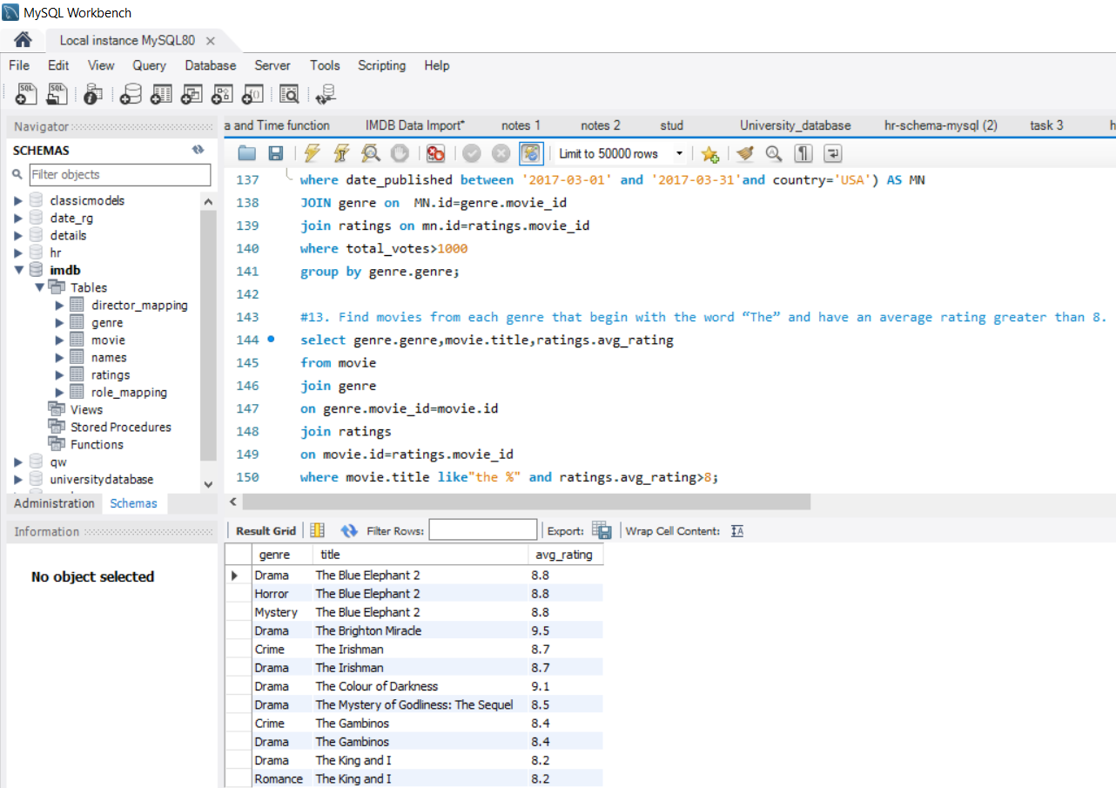
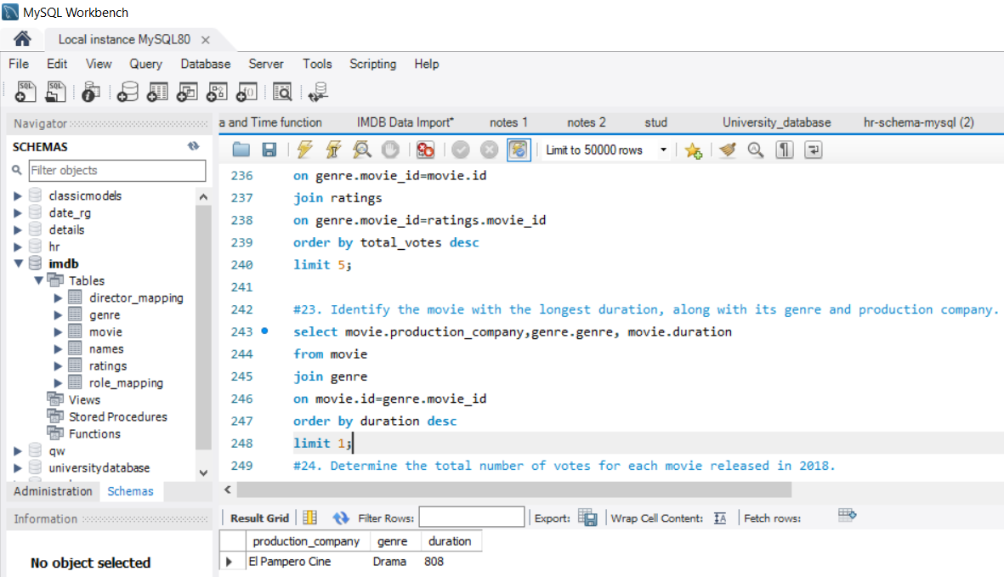
Findings & Insights (Part 1)
• The highest number of movies were released in [2017].
• The most common genre is [Drama] with 4285 movie count.
• Movies with 'The' in their title tend to have higher ratings.
• The longest movie in the dataset is [El Pampero Cine] with [808] minutes.

Slide 7
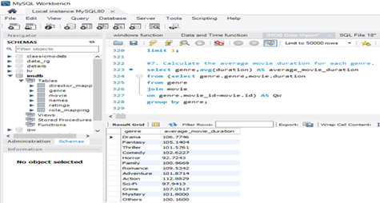
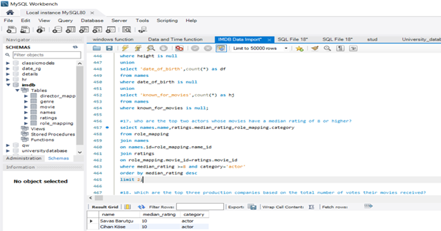
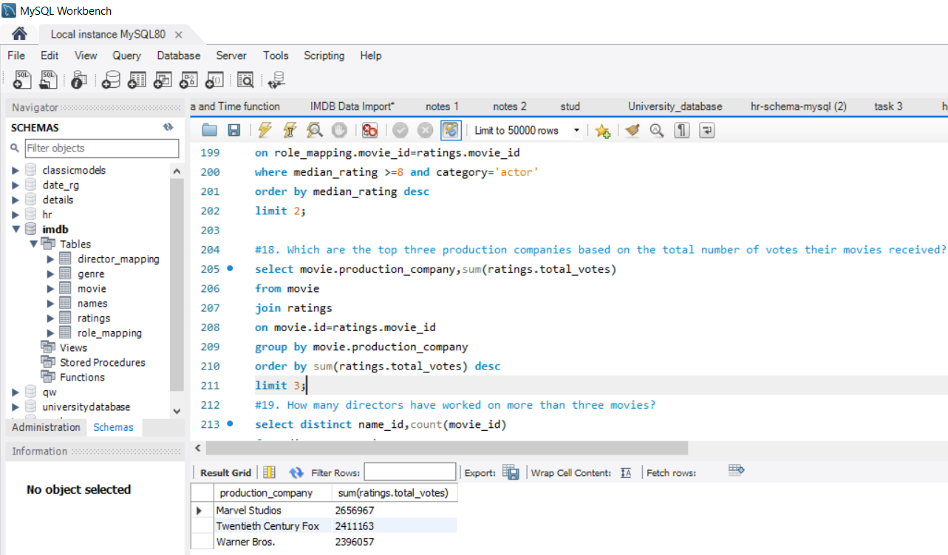
Findings & Insights (Part 2)
• Top production companies based on total votes are:
1. Marvel Studios with 2656967 votes
2. Twentieth Century Fox with 2411163 votes
3. Warner Bros with 2396057 votes
• The top two actors with movies rated 8 or higher are [Savas Barutçu] and [Cihan Köse].
• Average movie duration varies across genres, with [Drama] having the longest movies.

Slide 8
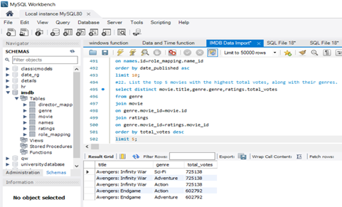
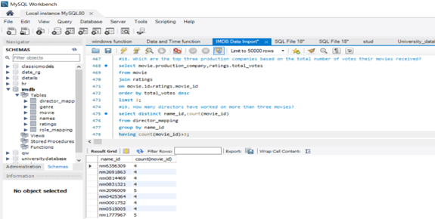
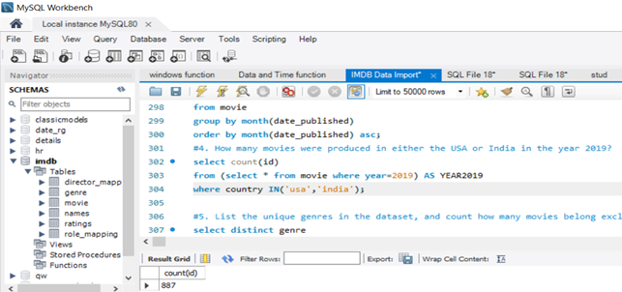
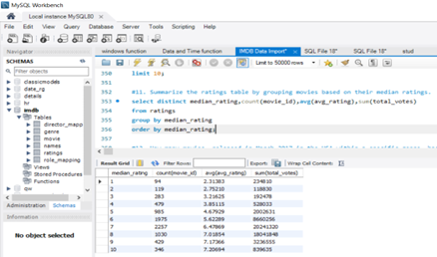
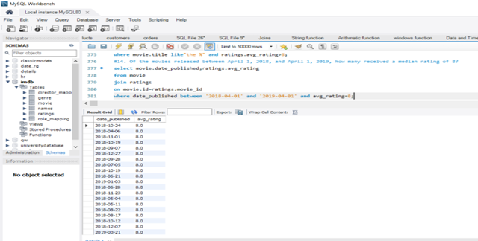
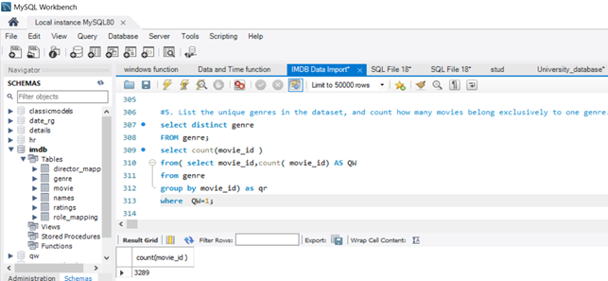
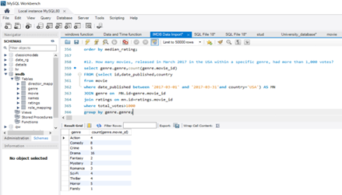
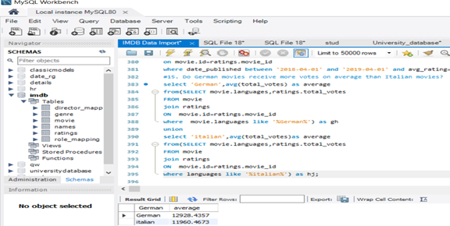
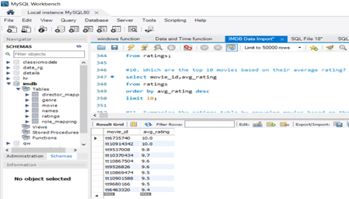

Slide 9
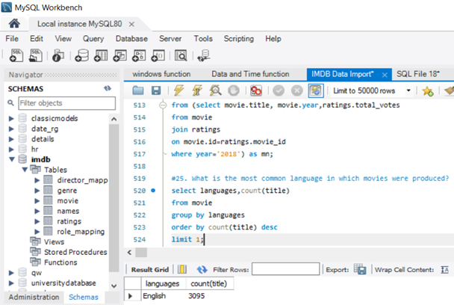
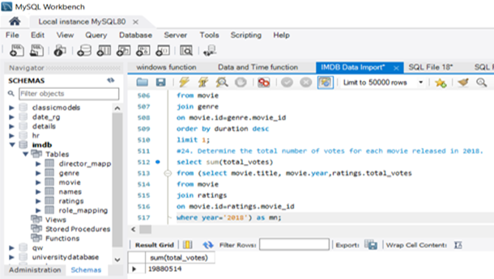
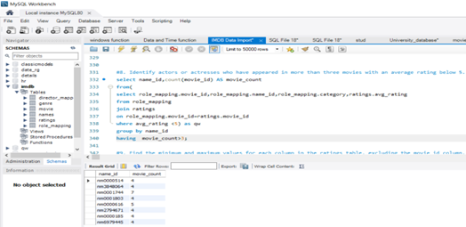

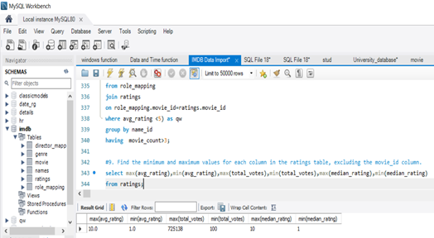

Slide 10
Conclusion
• The IMDB dataset provides rich insights into movie trends.
• SQL techniques such as joins, aggregation, and filtering were essential.
• Data helps film makers meet audience needs
• Future work could include deeper analysis on actors’ career trends.

Slide 11
Question & Answer
• Thank you for your time!
• Questions or discussions are welcome.

